Slide 1
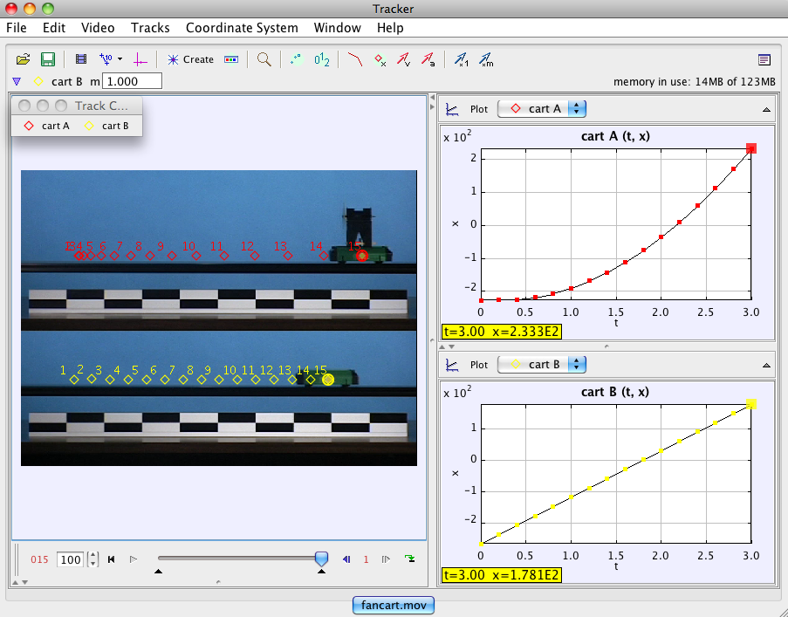
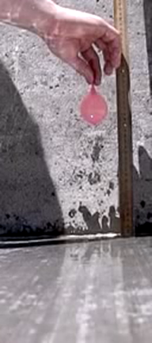
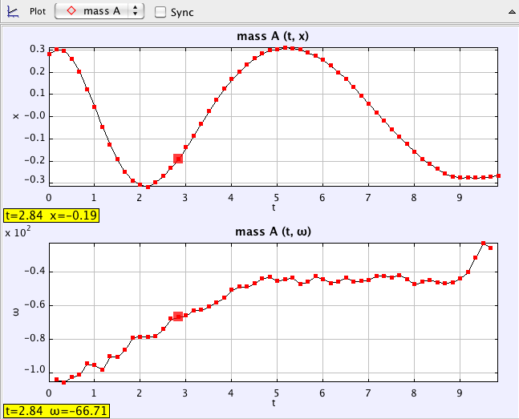
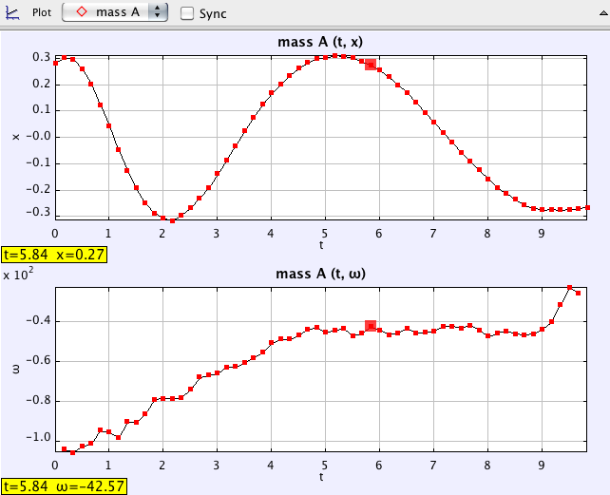
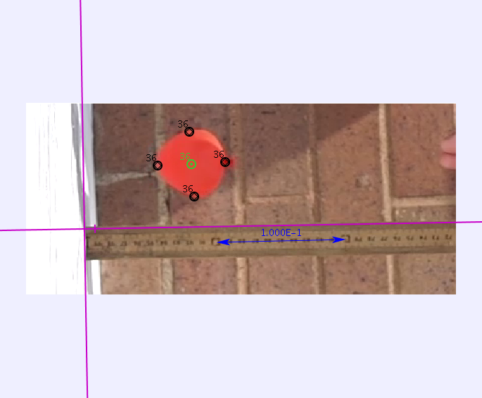
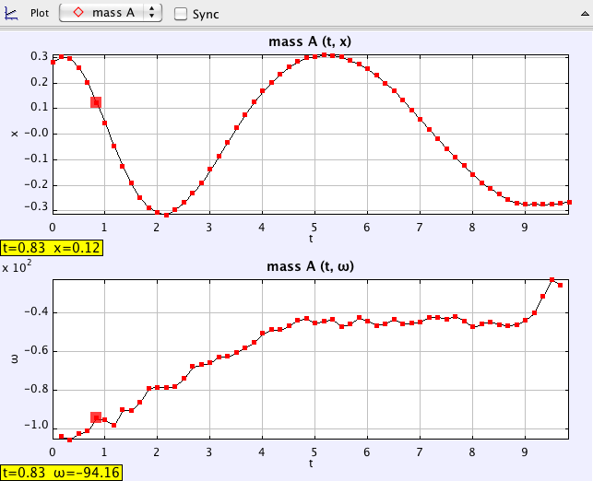
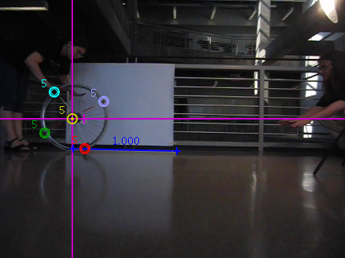
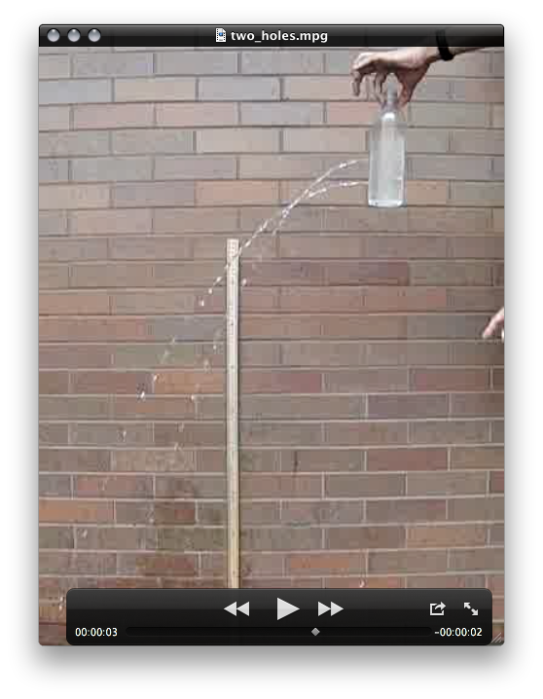
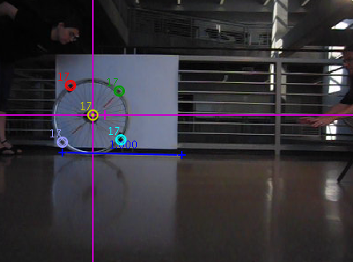
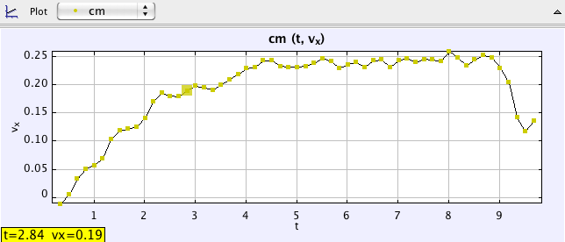
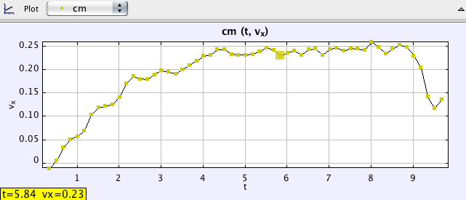
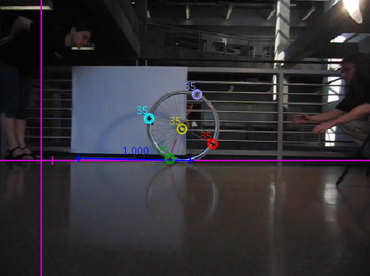
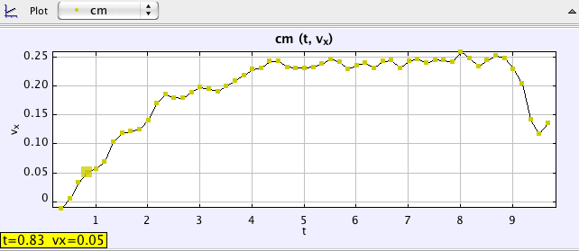
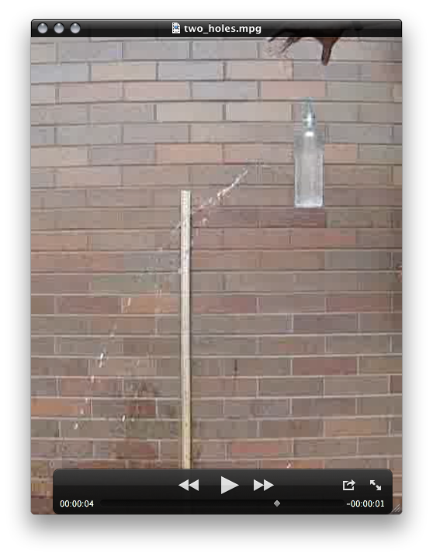
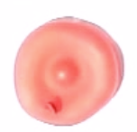
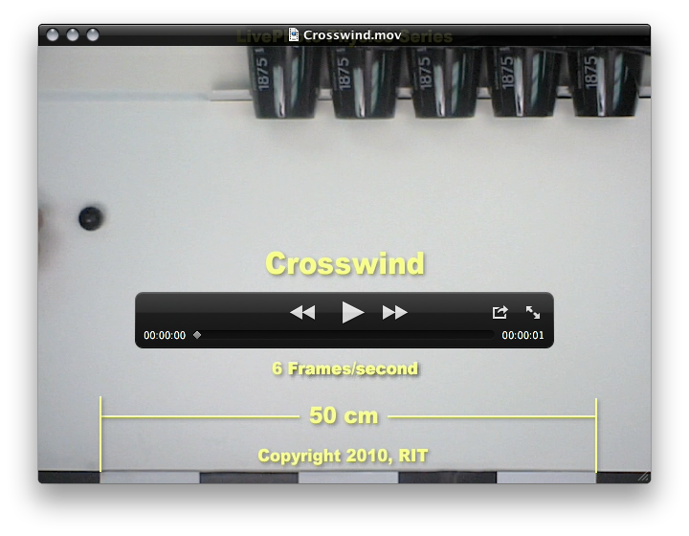
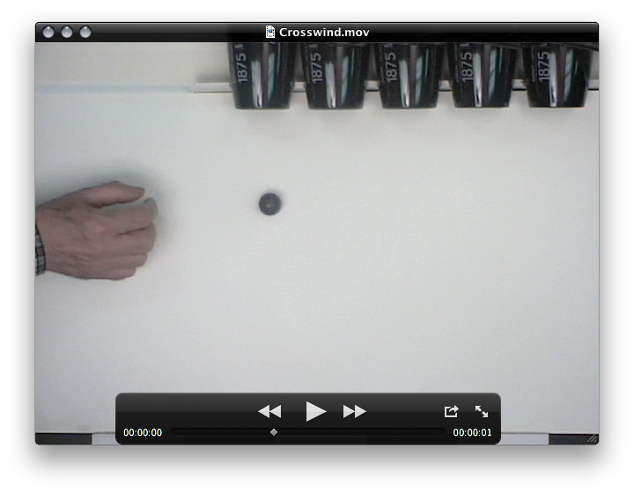
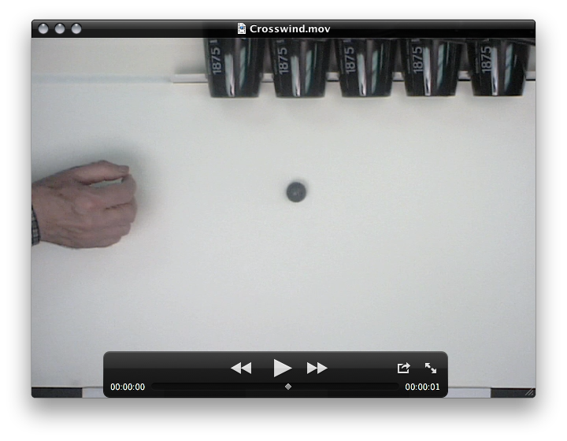
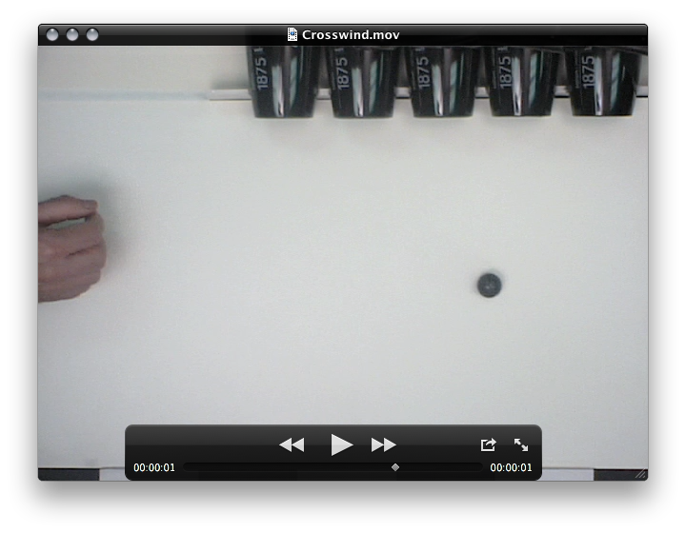
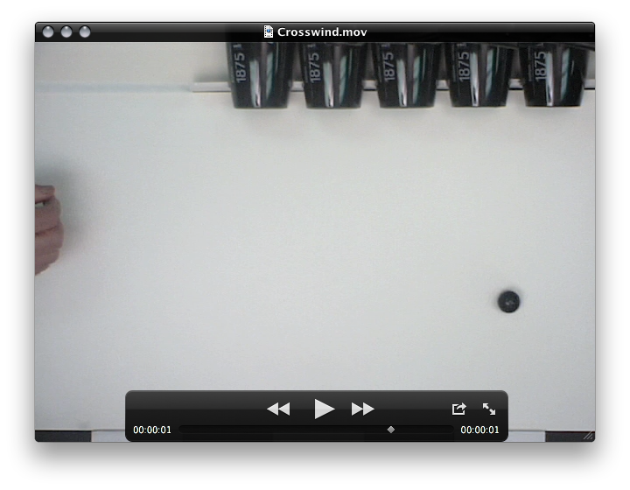
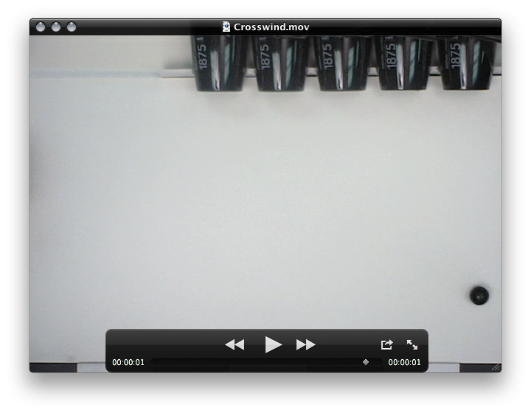
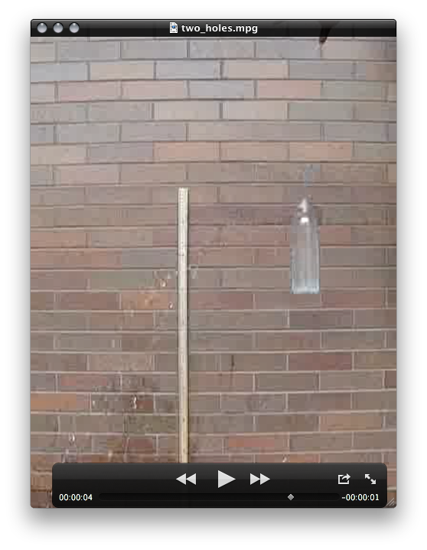
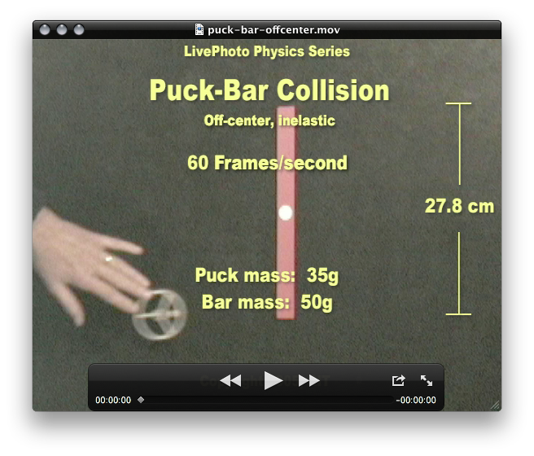
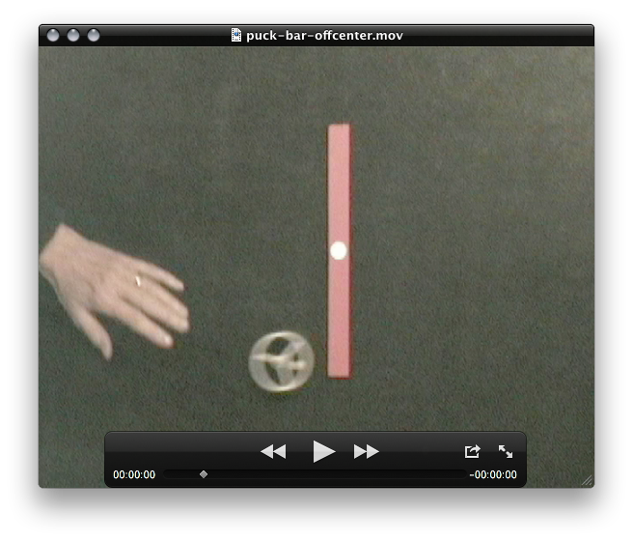
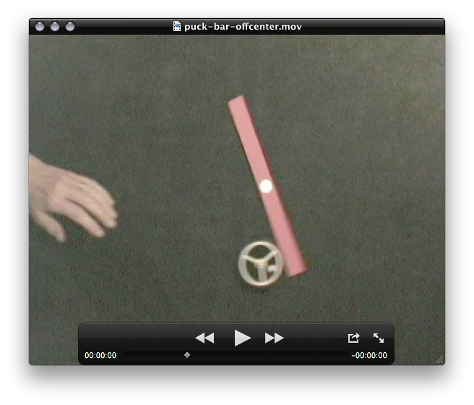
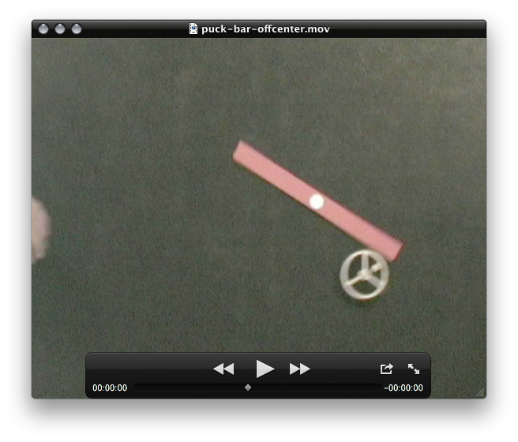
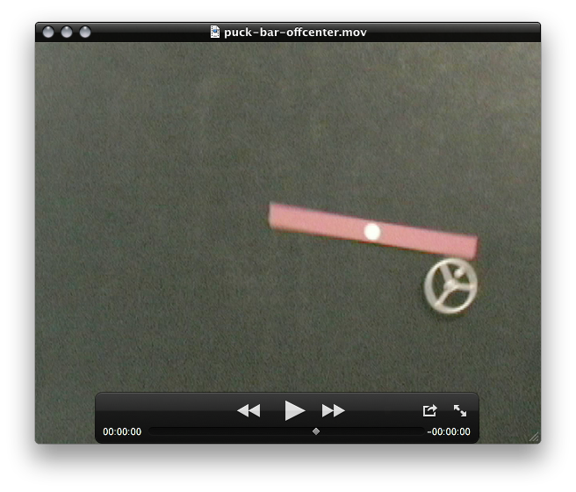
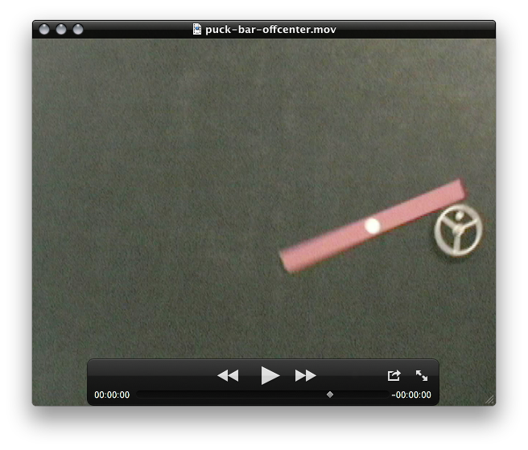
Physics with video analysis
Video analysis is a technique that allows for detailed study of all motion parameters and is a successful complementary activity to the traditional labs. It is particularly useful to analyze phenomena that cannot be easily reproduced in our classrooms. These are some experiments performed at the Live Photo Physics workshop (June 2011, RIT), and other examples from their website http://livephoto.rit.edu. At SCCC, video analysis was first introduced in our physics labs in 2012.
Dropping balloons containing different fluids
By K. Counts and J.Williams
Transition between sliding and rolling friction for a bicycle wheel
2
3
By G. Denicolo,
Kobayashi, and
C. Nakamura
1
Leaking bottle in free fall
1
By L. Freeman,
R. Rivera and F. Vera
Position of red dot in respect to CM.
2
3
Angular speed of red dot in respect to CM.
Measuring the coefficient of restitution
Cases 1 & 2: sliding + rolling friction.
Case 3: rolling friction took over when μ_{r} ≈ 0.2
Movie with 240 frames per second.
Linear speed of CM.
Crosswind (study of two dimensional motion and air resistance)
Oscillations in a single bounce
No water leaks as bottle falls
Puck and bar (study of conservation of linear and angular momenta)
ω = 153.6 ± 0.4 Hz
γ = 4.27 ± 0.41 s⁻¹

